Slide 1
Programming
(and Python,Git/Github)

Slide 2
High Level Overview
Start
Computer programs map input to output
You must know what you want, and what you have
Fundamental tools of program design
Data structures (storage)
Conditional statements (decisions)
Iterative statements (loops)
Functions (procedures)
Decision
End
Input
Loop
Storage
Procedure
Output

Slide 3
“python” installation
Don’t download Python!
Why?
Download Conda and Install Python (possibly for every project)
Download Miniconda and install (command-line) or Anaconda from anaconda.com
https://docs.conda.io/en/latest/miniconda.html
Conda is a package manager and virtual environment system rolled into one
Package manager - Finds and installs current/old versions of various tools (e.g. Python) and libraries
Virtual environment - Enables a group of specific versions to be used together for a project without conflicting with other versions.

Slide 4
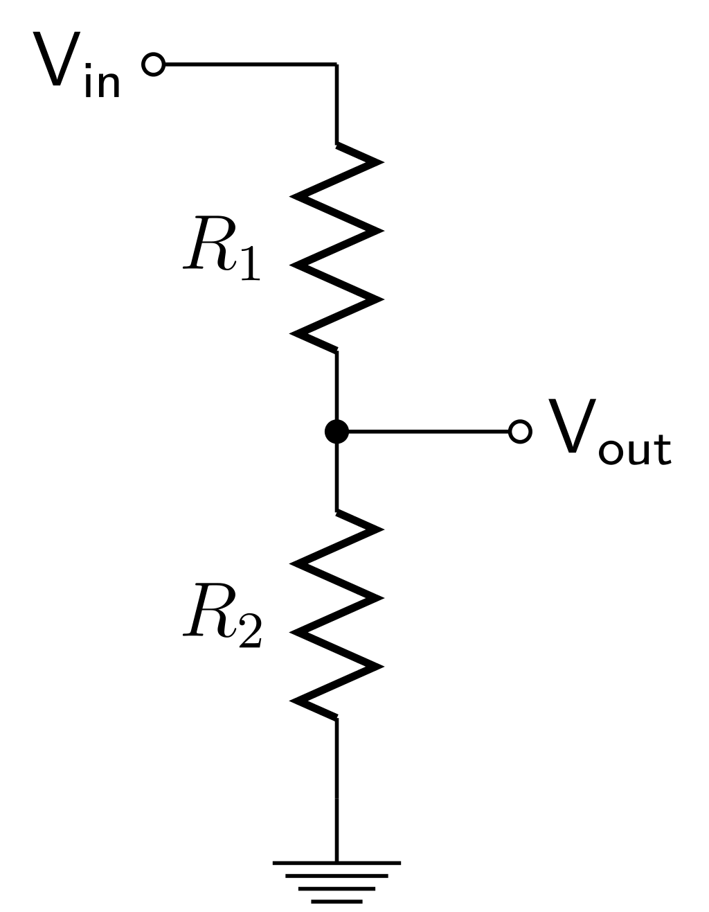
Let’s solve a simple problem
Solve for the output voltage, and the power dissipation of each resistor, given the two resistor values and input voltage, formatted nicely

Slide 5
Let’s share this through GitHub
GitHub - Online Server to Share and Manage remote Git Repositories
Git - Command-line tool to create and manage Git repositories
Git Repository - A folder on your computer that contains your files AND tracked changes to those files (called commits) inside a hidden .git folder, created and updated by the Git tool
Git Commit - A set of changes made to various files in the folder (relative to the last set of changes you made)
git clone url -> creates a copy of a remote repository on your computer, set up to track the remote repository (when using git push and pull)
git status -> shows the “state” of your repository
git add file1 file2… -> adds all changes to the specified files to the “staging area”
git reset -> unstages changes
git commit –m “commit message…” -> creates a commit from all changes in the staging area
git push -> attempts to add local commits to remote repositories (e.g., GitHub)
git pull -> attempts to retrieve (and merge) commits from remote repositories (e.g., GitHub)

Slide 6
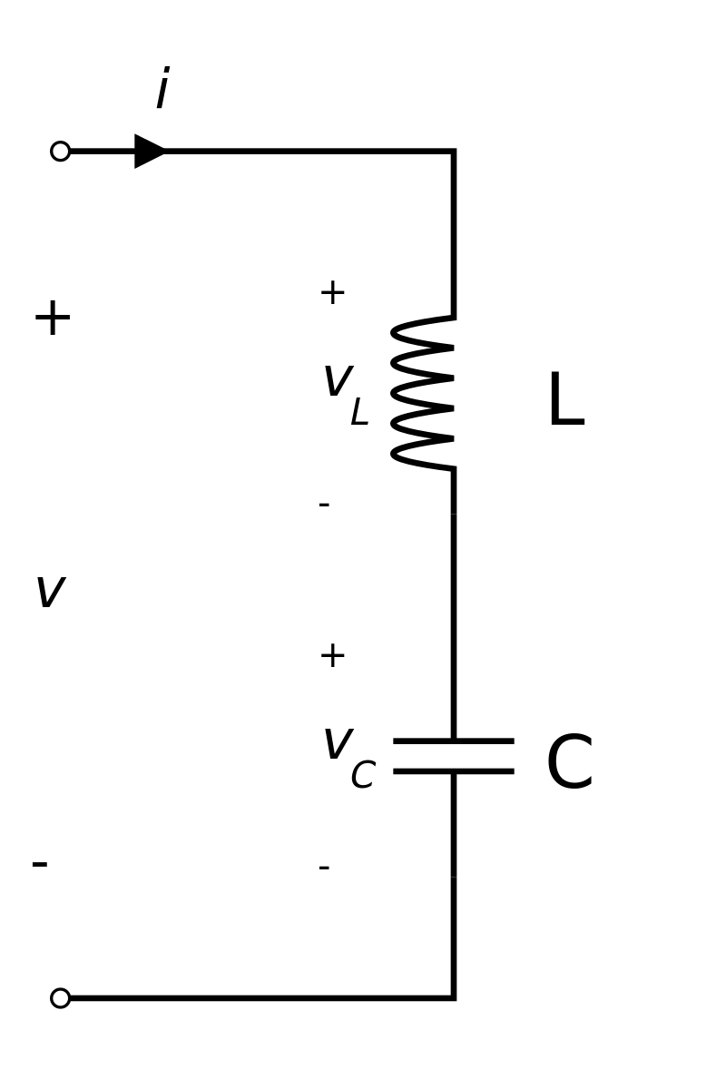
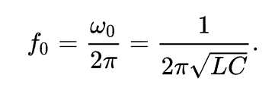
Let’s do it again!
Calculate the resonant frequency (in Hz) of an LC circuit, given L and C

Slide 7
And commit/push again
Let’s check GitHub and make sure everything is there too

Slide 8
Python Basics (Storage)
Storage
Objects
Any collection of data (bytes) and operations (functions that operate on said bytes)
Few “built-in” types, e.g.,
int (any size), float (64 bit), complex (3 + 4j)
str (any size)
bool (True or False)
Extendable through Classes (most python libraries)
Containers (lists, dictionaries, tuples, sets)
Indexed grouping of objects of any type
Examples: a_list = [1,2,3] (sequential (note: 0) numerical index) a_dict = {“key1”:1,”key2”:2,”key3”:3} (set index)
Files
Read and write, text or binary
Normally used with the “with” statement
with open(“myfile”,”r”) as f: or with open(“myfile”,”w”) as f:

Slide 9
Conditional Statements
Expression
IF-statements are the dominant form of conditional in almost all programming languages
Sometimes called a “guard”, because they protect code from executing unless a specific condition is met
Boolean conditional expression must evaluate to True for a body_block to execute
Python
if expression:
body_block
next code
False
True
Body Block
colon denotes a block statement
All code in a block is indented at the same level
Next Code

Slide 10
Iterative Statements (while)
Expression
Most fundamental type is the “while” statement
Same as an if-statement, but doesn’t continue to the next block until the statement becomes false
Sometimes called an “indefinite” looping statement, because the end isn’t necessarily apparent
Use the “break” statement to end immediately
Use the “continue” statement to skip back to the expression
Python
while expression:
body_block
next_code
False
True
Body Block
Next Code

Slide 11
Iterative Statements (for)
Get Next Value from Iterator
Exception
FOR-loops are a common and useful “upgrade” of a while loop to focus on iterating through a container type
Executes a block of code once for each object in the container (in sequence)
index variable assigned to the current item in the container while the body_block is executing
containers are any iterable type (implements __iter__, e.g. lists, dictionaries)
Python
Body Block
Next Code
iterator = iter(container)
while True:
index_var = next(iterator)
body_block
for index_var in container:
body_block
next_code
Similar to

Slide 12
Functions
Functions are how we manage complexity and code-reuse in programming
Any part of a program that turns input into output can be made into a function consisting of
input values
body statements (procedure)
output values (return statement)
Variables assigned inside the function are not available outside of the function, unless declared “global”
Variables NOT assigned inside the function refer to variables outside of the function (bad practice)
Python
def function_name(input_var1,input_var2):
body_block
return ret_value
output_var = function_name(value1,value2)
input_var1 = value1
input_var2 = value2
body_block
output_var = ret_value

Slide 13
Classes & Objects
One of the most powerful tools you have to manage program complexity by compositing code and data into a single logical entity (an object)
Python creates objects from class definitions
Classes define an initialization function, which can modify the object “self” according to other passed variables
Classes can define other functions, which can use the data in “self”, including special functions that can even adjust the behavior of operators used between “self” and other objects, or with commands

Slide 14
Example Class
class Bucket:
def __init__(self, full_capacity, initial_volume):
self.capacity = full_capacity
self.current_volume = initial_volume
def __str__(self):
return f"Capacity: {self.capacity}, " + \
f"Current: {self.current_volume}, "+ \
f"To Full: {self.capacity_left()}"
def __repr__(self):
return f"Bucket({self.capacity},{self.current_volume})"
def capacity_left(self):
return self.capacity - self.current_volume
def fill(self, amount):
if amount < 0:
raise Exception("amount must be non-negative")
new_volume = self.current_volume + amount
if new_volume > self.capacity: # overflow
self.current_volume = self.capacity
return new_volume - self.capacity
else:
self.current_volume = new_volume
return 0 # used all of it
def pour(self, amount):
if amount < 0:
raise Exception("amount must be non-negative")
if self.current_volume >= amount: # enough available
self.current_volume -= amount
return 0
else: # we are trying to pour too much
to_return = amount - self.current_volume
self.current_volume = 0
return to_return
This class represents a bucket that can be filled and poured
The class defined an object with two state variables, capacity, and current volume
It has “methods” to fill and pour, which return any overflow/underflow
You create objects by using the class name as a function
a = Bucket(30,15) # creates a bucket with a capacity of 30, filled to 15 units
You use object properties and methods via the variable name
a.pour(7) # The bucket has 8 remaining
a.fill(15) # The bucket now has 23 remaining
print(a) # This will show that it has a capacity of 30, 23 filled, and 7 to go

Slide 15
Real Programs
Process real world input (almost always)
Sensors (input devices)
Files (larger than could be hand-entered)
Networking
Produce useful visualizations / outputs
To an output device
To files
To the network
Almost always use libraries of existing functions/classes to accomplish tasks

